Slide 1

Transactions

Slide 2



Transactions
Transaction Concept Transaction State Concurrent Executions Serializability Implementation of Isolation

Slide 3


Introduction to Transaction Processing
Single-User System:
At most one user at a time can use the system.
Multiuser System:
Many users can access the system concurrently.
Concurrency
Interleaved processing:
Concurrent execution of processes is interleaved in a single
CPU
Parallel processing:
Processes are concurrently executed in multiple CPUs.

Slide 4



Introduction to Transaction Processing (Contd..)
A Transaction:
Logical unit of database processing that includes one or more access operations (read -retrieval, write - insert or update, delete).
A transaction (set of operations) may be stand-alone specified in a high level language like SQL submitted interactively, or may be embedded within a program.
Transaction boundaries:
Begin and End transaction.
An application program may contain several transactions separated by the Begin and End transaction boundaries

Slide 5


Introduction to Transaction Processing (Contd..)
SIMPLE MODEL OF A DATABASE (for purposes of discussing transactions):
A database is a collection of named data items
Granularity of data - a field, a record , or a whole
disk block
Basic operations are read and write read_item(X): Reads a database item named X
into a program variable. To simplify our notation, we assume that the program variable is also named X.
write_item(X): Writes the value of program
variable X into the database item named X.

Slide 6
Introduction to Transaction Processing
READ AND WRITE OPERATIONS:
Basic unit of data transfer from the disk to the computer main memory is one block. In general, a data item (what is read or written) will be the field of some record in the database, although it may be a larger unit such as a record or even a whole block.
read_item(X) command includes the following steps:
Find the address of the disk block that contains item X.
Copy that disk block into a buffer in main memory (if that disk block is not already in some main memory buffer).
Copy item X from the buffer to the program variable named X.

Slide 7
Introduction to Transaction Processing
READ AND WRITE OPERATIONS (contd.):
write_item(X) command includes the following steps:
Find the address of the disk block that contains item X.
Copy that disk block into a buffer in main memory (if that disk block is not already in some main memory buffer).
Copy item X from the program variable named X into its correct location in the buffer.
Store the updated block from the buffer back to disk
(either immediately or at some later point in time).

Slide 8
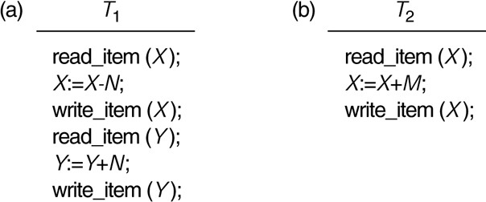
Two sample transactions
FIGURE 17.2 Two sample transactions:
Transaction T1
Transaction T2

Slide 9
Transaction State
Active – the initial state; the transaction stays in this state while it is
executing
Partially committed – after the final statement has been executed.
Failed -- after the discovery that normal execution can no longer proceed.
Aborted – after the transaction has been rolled back and the database restored to its state prior to the start of the transaction. Two options after it has been aborted:
restart the transaction
 can be done only if no internal logical error
kill the transaction
Committed – after successful completion.

Slide 10
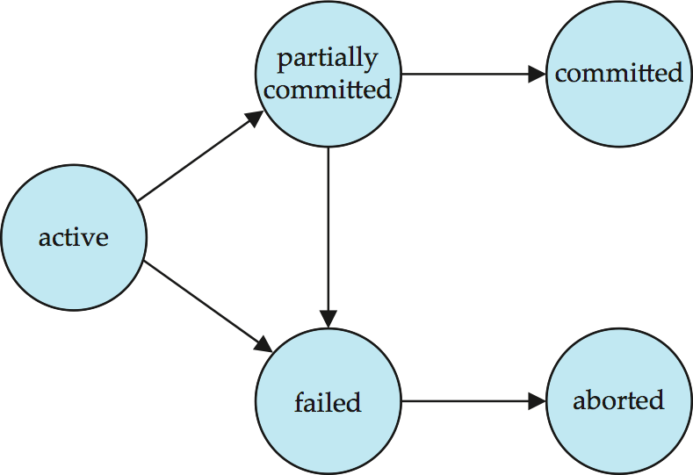
Transaction State (Cont.)

Slide 11

Transaction Concept
A transaction is a unit of program execution that accesses and possibly updates various data items.
E.g. transaction to transfer $50 from account A to account B:
read(A)
2. A := A – 50
write(A)
read(B)
5. B := B + 50
6. write(B)
Two main issues to deal with:
Failures of various kinds, such as hardware failures and system crashes
Concurrent execution of multiple transactions

Slide 12



Example of Fund Transfer
Transaction to transfer $50 from account A to account B:
1. read(A)
2. A := A – 50
write(A)
read(B)
5. B := B + 50
6. write(B)
Atomicity requirement
if the transaction fails after step 3 and before step 6, money will be “lost” leading to an inconsistent database state
 Failure could be due to software or hardware
the system should ensure that updates of a partially executed
transaction are not reflected in the database
Durability requirement — once the user has been notified that the transaction has completed (i.e., the transfer of the $50 has taken place), the updates to the database by the transaction must persist even if there are software or hardware failures.

Slide 13
Example of Data Access
buffer
Buffer Block A
Buffer Block B
input(A)
A B
X
Y
output(B)
read(X)
write(Y)
x₂
x₁ y₁
work area of T₁
work area
of T₂
memory
disk

Slide 14

Example of Fund Transfer (Cont.)
Transaction to transfer $50 from account A to account B:
1. read(A)
2. A := A – 50
write(A)
read(B)
5. B := B + 50
write(B)
Consistency requirement in above example:
the sum of A and B is unchanged by the execution of the transaction In general, consistency requirements include
Explicitly specified integrity constraints such as primary keys and foreign keys
Implicit integrity constraints
– e.g. sum of balances of all accounts, minus sum of loan amounts
must equal value of cash-in-hand
A transaction must see a consistent database.
During transaction execution the database may be temporarily inconsistent.
When the transaction completes successfully the database must be
consistent
Erroneous transaction logic can lead to inconsistency

Slide 15
Example of Fund Transfer (Cont.)
Isolation requirement — if between steps 3 and 6, another transaction T2 is allowed to access the partially updated database, it will see an inconsistent database (the sum A + B will be less than it should be).
T1
1. read(A)
2. A := A – 50
3. write(A)
T2
read(A), read(B), print(A+B)
4. read(B)
5. B := B + 50
6. write(B
Isolation can be ensured trivially by running transactions serially
that is, one after the other.
However, executing multiple transactions concurrently has
significant benefits, as we will see later.

Slide 16

ACID Properties
A transaction is a unit of program execution that accesses and possibly updates various data items.To preserve the integrity of data the database system must ensure:
Atomicity. Either all operations of the transaction are properly reflected in the database or none are.
Consistency. Execution of a transaction in isolation preserves the
consistency of the database.
Isolation. Although multiple transactions may execute concurrently, each transaction must be unaware of other concurrently executing transactions. Intermediate transaction results must be hidden from other concurrently executed transactions.
That is, for every pair of transactions T_{i} and T_{j}, it appears to T_{i} that either T_{j}, finished execution before T_{i} started, or T_{j} started execution after T_{i} finished.
Durability. After a transaction completes successfully, the changes it
has made to the database persist, even if there are system failures.

Slide 17
Concurrent Executions
Multiple transactions are allowed to run concurrently in the system.
Advantages are:
increased processor and disk utilization, leading to better transaction throughput
E.g. one transaction can be using the CPU while another is
reading from or writing to the disk
reduced average response time for transactions: short transactions need not wait behind long ones.
Concurrency control schemes – mechanisms to achieve isolation
that is, to control the interaction among the concurrent transactions in order to prevent them from destroying the consistency of the database
Will study in Chapter 16, after studying notion of correctness of concurrent executions.

Slide 18

Schedules
Schedule – a sequences of instructions that specify the chronological
order in which instructions of concurrent transactions are executed
a schedule for a set of transactions must consist of all instructions of those transactions
must preserve the order in which the instructions appear in each
individual transaction.
A transaction that successfully completes its execution will have a commit instructions as the last statement
by default transaction assumed to execute commit instruction as its last step
A transaction that fails to successfully complete its execution will have an abort instruction as the last statement

Slide 19


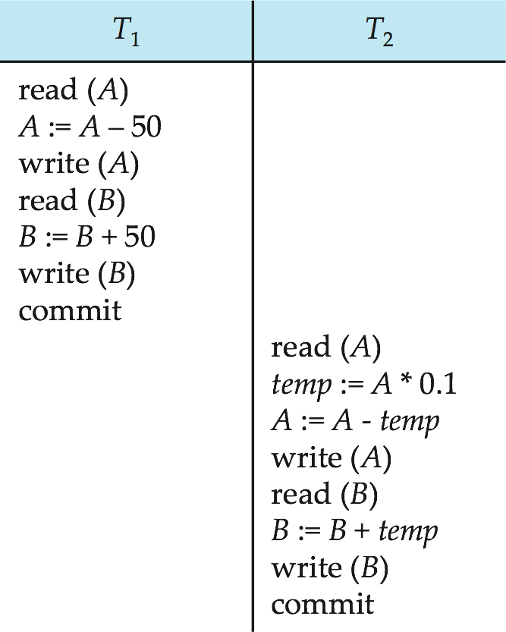
Schedule 1
Let T₁ transfer $50 from A to B, and T₂ transfer 10% of the balance from A to B.
A serial schedule in which T₁ is followed by T₂ :

Slide 20

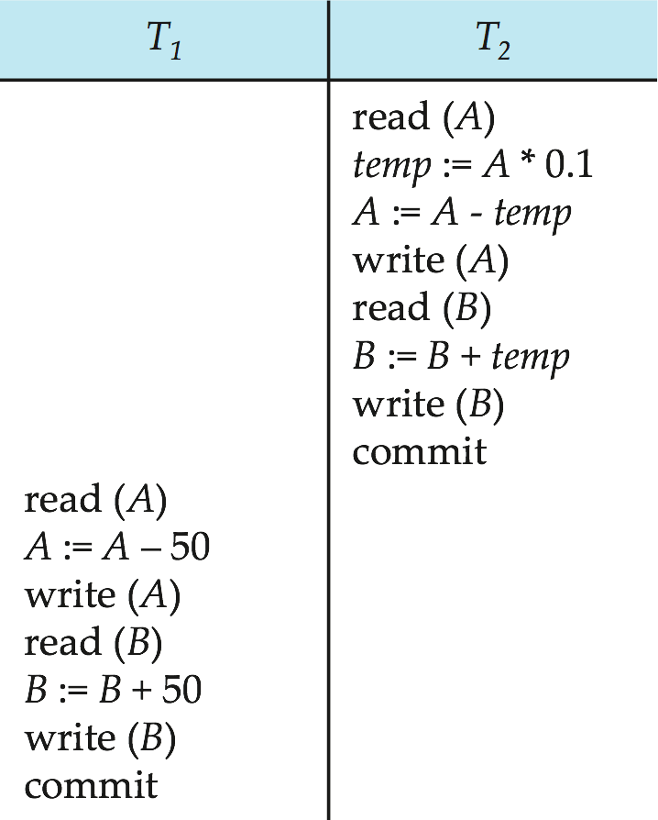
Schedule 2
A serial schedule where T₂ is followed by T₁

Slide 21

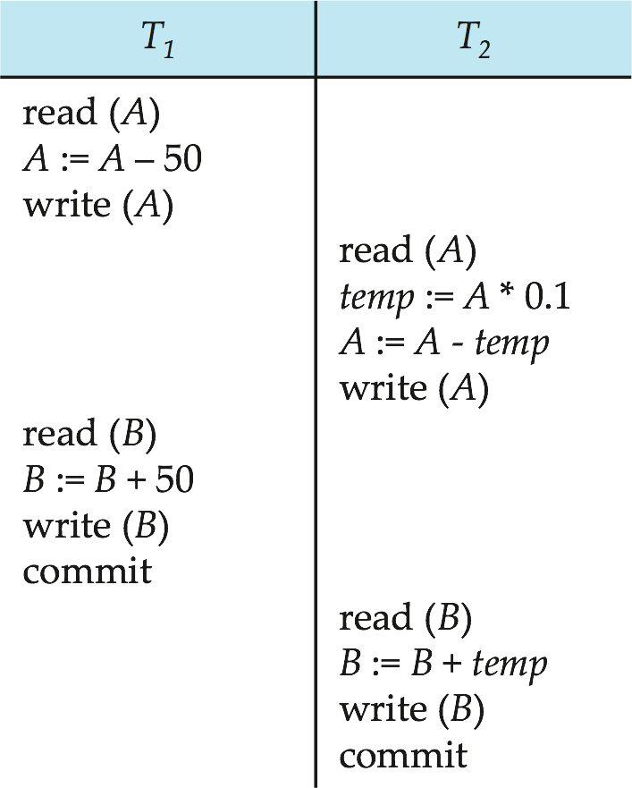
Schedule 3
Let T₁ and T₂ be the transactions defined previously. The following schedule is not a serial schedule, but it is equivalent to Schedule 1.
In Schedules 1, 2 and 3, the sum A + B is preserved.

Slide 22

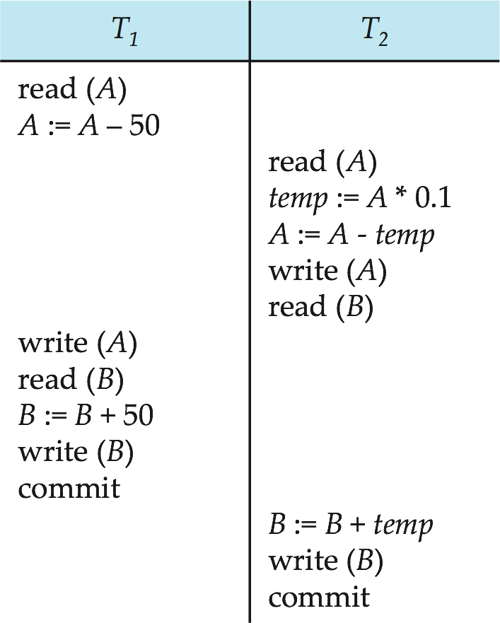
Schedule 4
The following concurrent schedule does not preserve the value of (A + B ).

Slide 23

Transaction Processing
Why Concurrency Control is needed:
The Lost Update Problem
This occurs when two transactions that access the same database items have their operations interleaved in a way that makes the value of some database item incorrect.
The Temporary Update (or Dirty Read) Problem
This occurs when one transaction updates a database item and then the transaction fails for some reason (see Section 17.1.4).
The updated item is accessed by another transaction before it
is changed back to its original value.
The Incorrect Summary Problem
If one transaction is calculating an aggregate summary function on a number of records while other transactions are updating some of these records, the aggregate function may calculate some values before they are updated and others after they are updated.

Slide 24
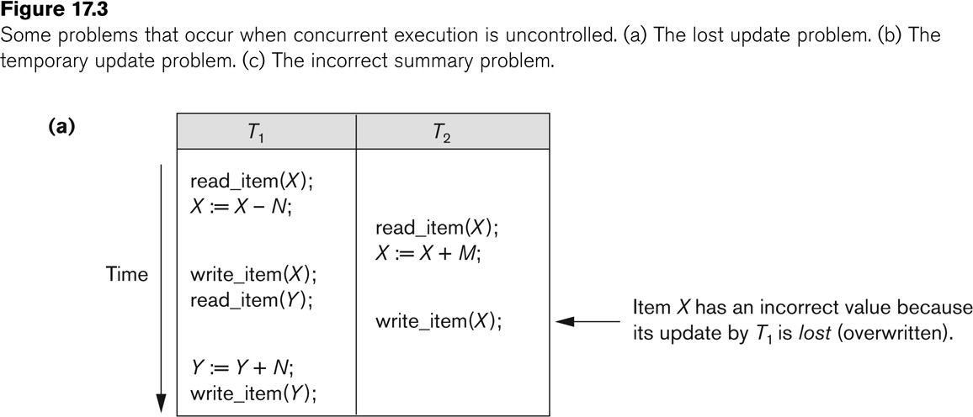
Concurrent execution is uncontrolled:
(a) The lost update problem.

Slide 25

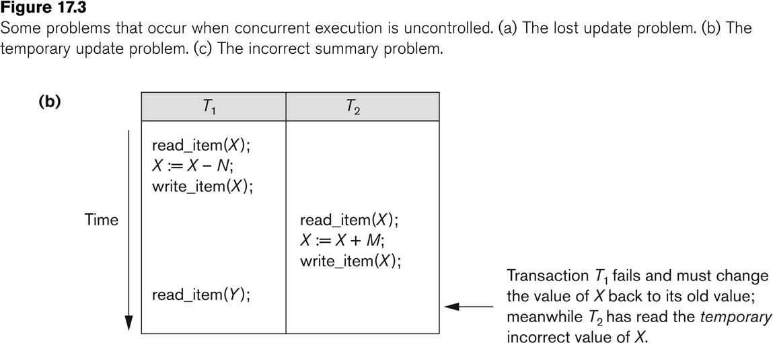
Concurrent execution is uncontrolled:
(b) The temporary update problem.

Slide 26

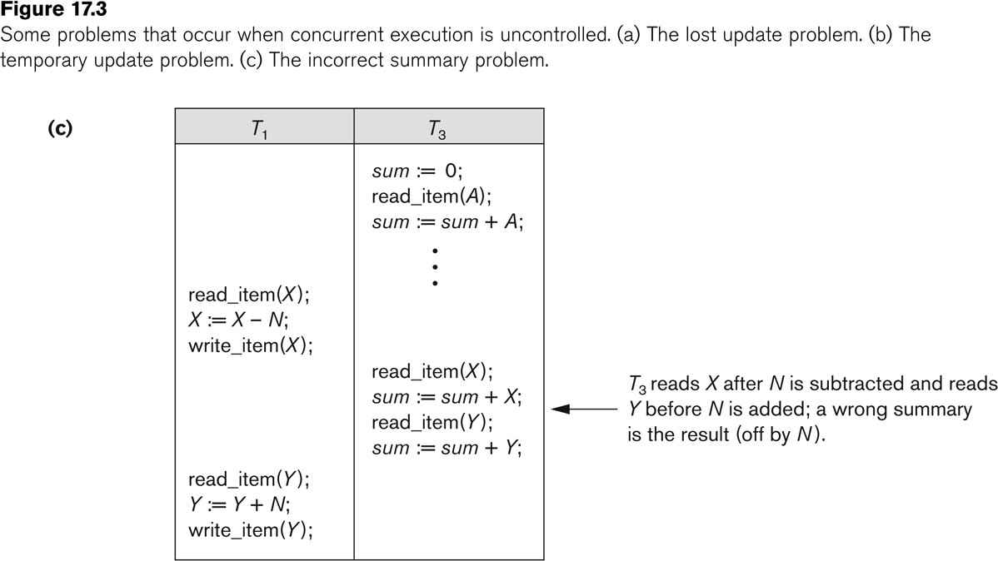
Concurrent execution is uncontrolled:
(c) The incorrect summary problem.
Slide 17- 26

Slide 27
Example for The Lost Update Problem
Lost update problem: A lost update is a typical problem in transaction processing in SQL. It happens when two queries access and update the same data from a database. This problem can be understood by the below given diagram. Here, A is processing an order for a client for 150 items. He checks from the ITEMS table that there are 300 available items. So he starts placing the order. After few seconds B gets an order for 200 items. He also checks the items table and finds that there are 300 items available. So he also starts placing an order.
Meanwhile A confirms the order for 150 items and updates the ITEMS table and sets the quantity to 150. A few seconds later B confirms the order and updates the ITEMS table and sets the quantity to 100. This problem is known as lost update problem because both the orders of the users A and B have been accepted, but there is not enough items available. Hence, the updates are lost.

Slide 28
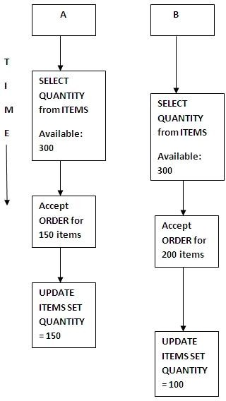
Example for The Lost Update Problem

Slide 29

Example for Uncommitted or Dirty read
Problem
In a dirty read problem, A is processing an order for a client for 150 items. He checks from the ITEMS table that there are 300 available items. So he starts placing the order. A confirms the order for 150 items and updates the ITEMS table and sets the quantity to 150. Now, B receives an order for 200 items. He checks the ITEMS table to find that there is not enough inventories (150 available) and rejects the order. By using business rules and transactions a note is sent informing that more items are required. Now, due to some reason client asks A to cancel the order, so A cancels the order, rolls back and updates the ITEMS table back to 300 items. This problem is known as dirty read because B saw the uncommitted update of A.

Slide 30

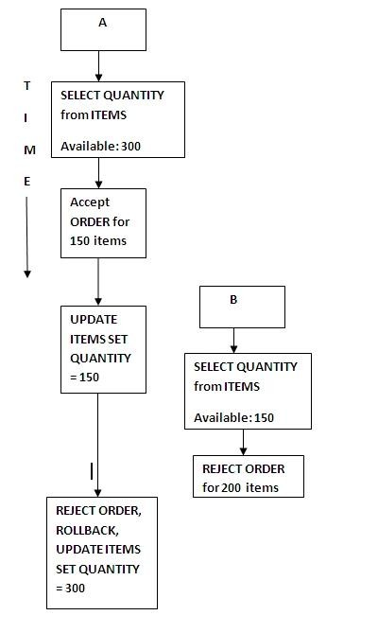
Example for Uncommitted or Dirty Read Problem

Slide 31

Serializability
Basic Assumption – Each transaction preserves database
consistency.
Thus serial execution of a set of transactions preserves database consistency.
A (possibly concurrent) schedule is serializable if it is equivalent to a serial schedule. Different forms of schedule equivalence give rise to the notions of:
conflict serializability
view serializability

Slide 32
Simplified view of transactions
We ignore operations other than read and write
instructions
We assume that transactions may perform arbitrary computations on data in local buffers in between reads and writes.
Our simplified schedules consist of only read and write
instructions.

Slide 33
Conflicting Instructions
Instructions l_{i} and l_{j} of transactions T_{i} and T_{j} respectively, conflict if and only if there exists some item Q accessed by both l_{i} and l_{j}, and at least one of these instructions wrote Q.
l_{i} = read(Q), l_{j} = read(Q). l_{i} and l_{j} don’t conflict.
l_{i} = read(Q), l_{j} = write(Q). They conflict.
l_{i} = write(Q), l_{j} = read(Q). They conflict
l_{i} = write(Q), l_{j} = write(Q). They conflict
Intuitively, a conflict between l_{i} and l_{j} forces a (logical) temporal order between them.
If l_{i} and l_{j} are consecutive in a schedule and they do not conflict, their results would remain the same even if they had been interchanged in the schedule.

Slide 34
Conflict Serializability
If a schedule S can be transformed into a schedule S´ by a series of swaps of non-conflicting instructions, we say that S and S´ are conflict equivalent.
We say that a schedule S is conflict serializable if it is conflict
equivalent to a serial schedule

Slide 35
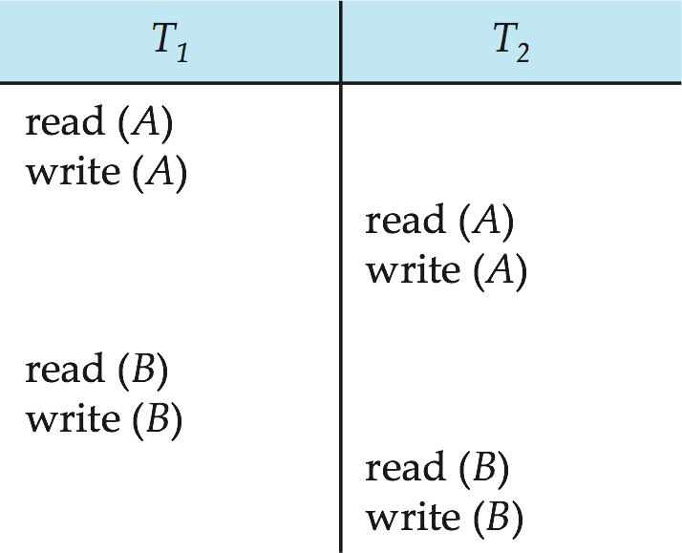
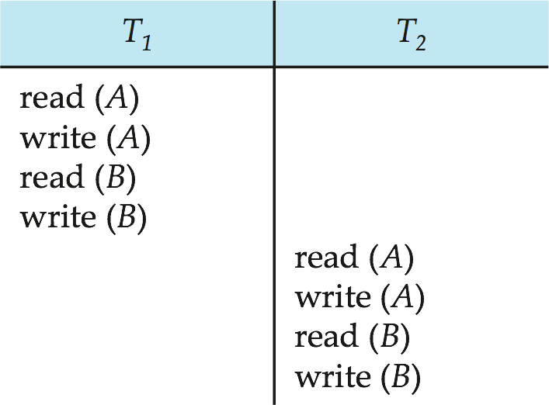
Conflict Serializability (Cont.)
Schedule 3 can be transformed into Schedule 6, a serial schedule where T₂ follows T₁, by series of swaps of non- conflicting instructions. Therefore Schedule 3 is conflict serializable.
Schedule 3
Schedule 6

Slide 36

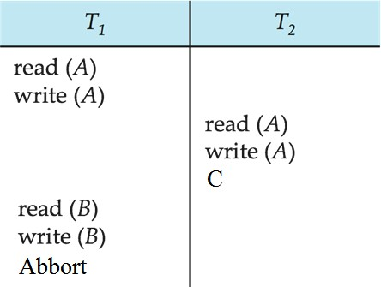
Anomalies with Interleaved Execution
Reading Uncommitted Data (WR Conflicts, “dirty reads”):

Slide 37
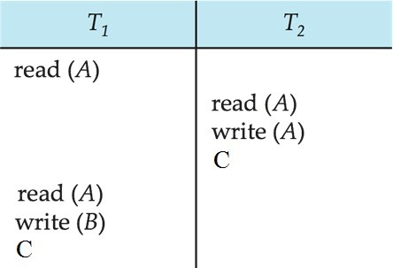
Anomalies with Interleaved Execution
Unrepeatable Reads (RW Conflicts):

Slide 38
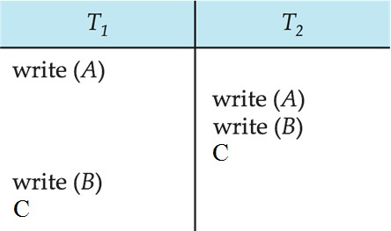
Anomalies (Continued)
Overwriting Uncommitted Data (WW Conflicts):

Slide 39

Thank You

